Slide 1


Slide 2

Android App For Location Based Services

Slide 3
Group Members Introduction
VU ID: BC180405476
Group ID: F2102E3A36

Slide 4

INTRODUCTION OF PROJECT
Many of our daily life activities are location based and we may forget to keep track of all the activities associated with a certain place. In order to keep track of all the activities associated with a certain place, this application will remind the users about any work when he is at a certain location. This application will require GPS (Global Positioning System) services of the mobile to keep track of the current user location.

Slide 5
User will add the tasks associated to a particular place in the application along with the location.
Application will continuously monitor the location of the user and will generate a notification or alarm to intimate the user as he reaches at the task location.
This application will also allow the user to automatically change mobile sound (ringer) settings associated at a particular location

Slide 6
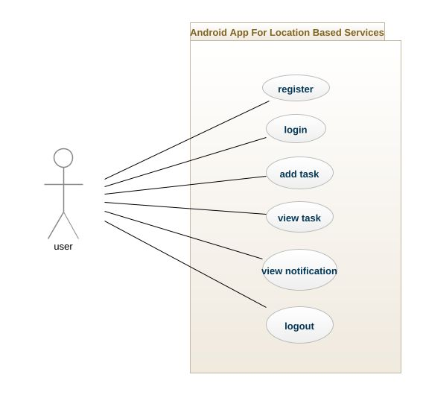
Use Case Diagram

Slide 7
Business Rules Catalog
This app is in English language it make it easy for user to understand.
This app make it easy for user to remember every task through location notification

Slide 8
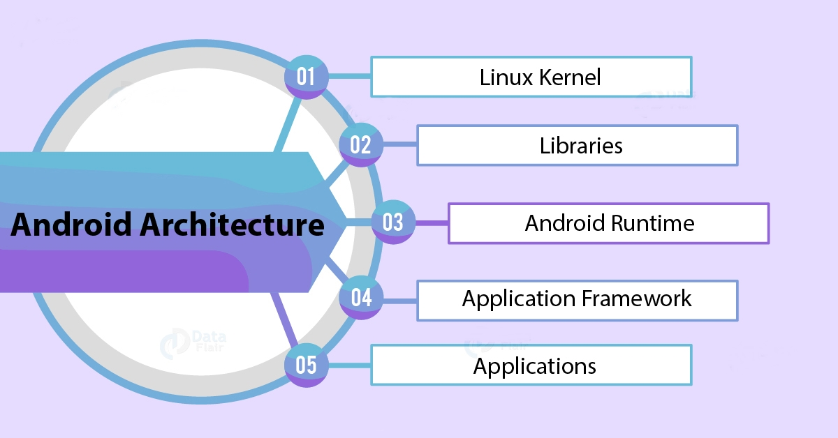
Architectural Design

Slide 9
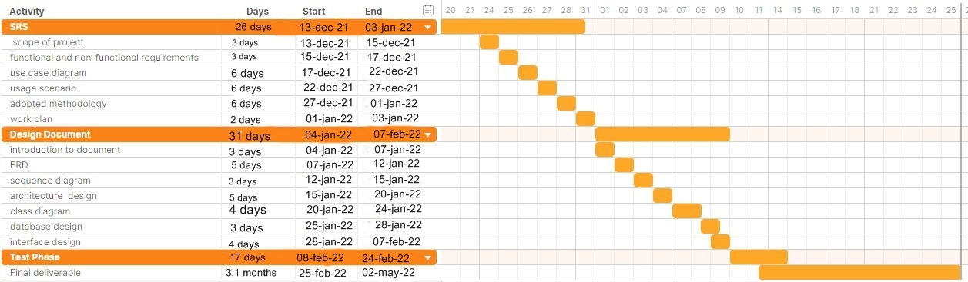
Project Schedule

Slide 10
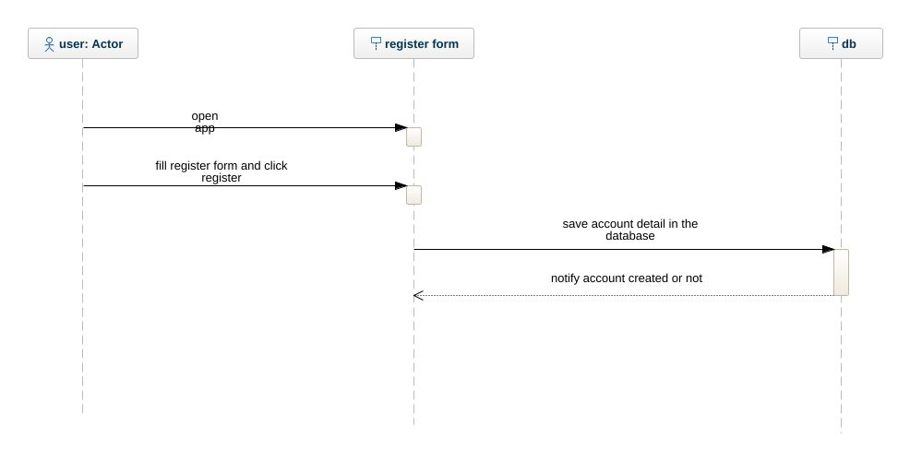
Sequence Diagrams
1. register

Slide 11
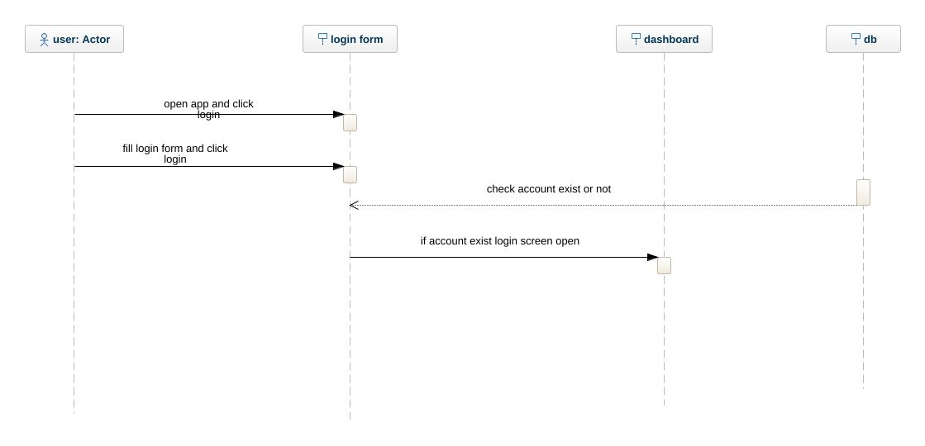
Sequence Diagrams
2.login

Slide 12
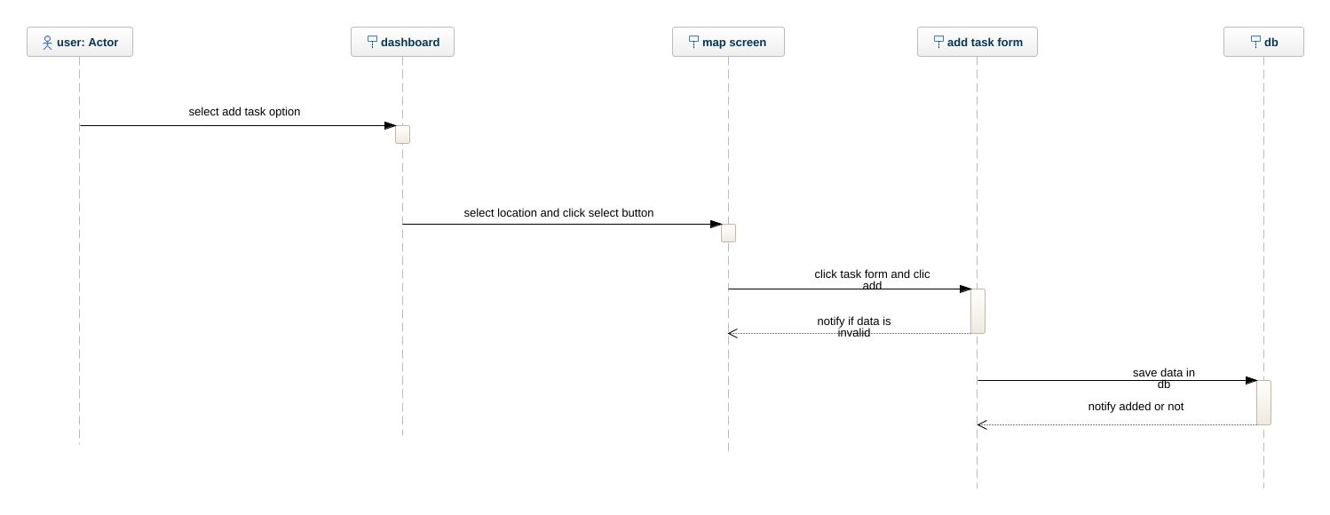
Sequence Diagrams
3. Add tasks

Slide 13
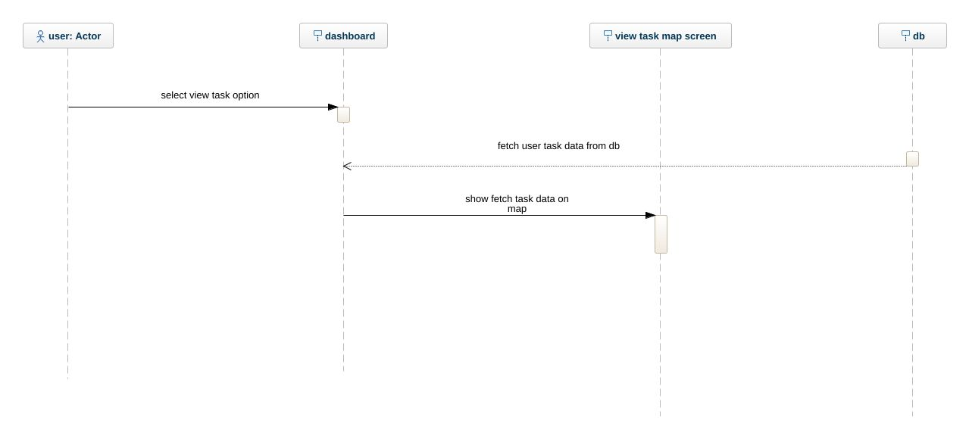
Sequence Diagrams
4. View task

Slide 14
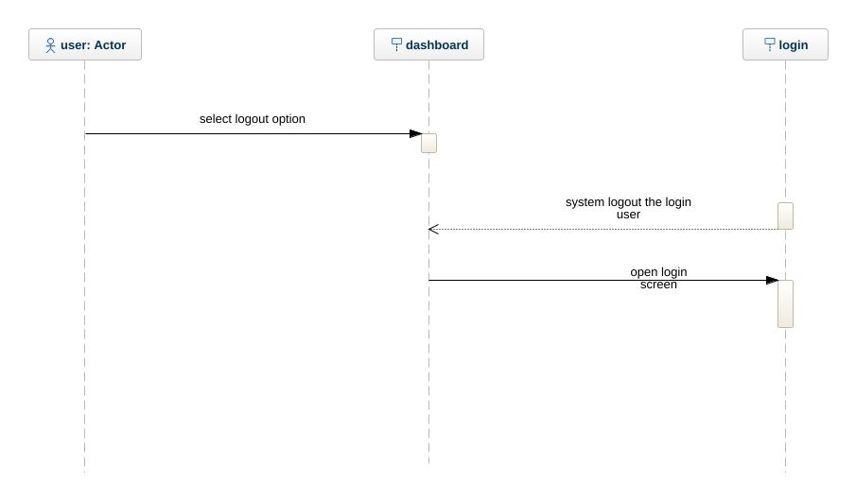
Sequence Diagrams
5. logout

Slide 15
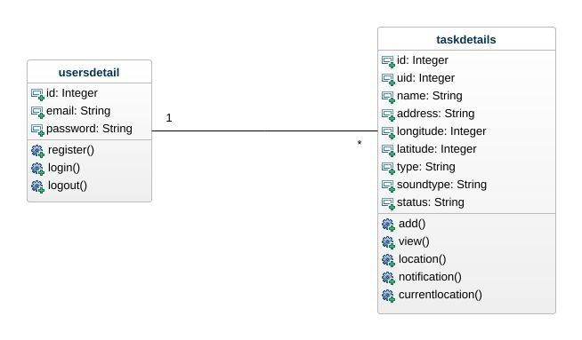
Logical Model/Class Diagram

Slide 16
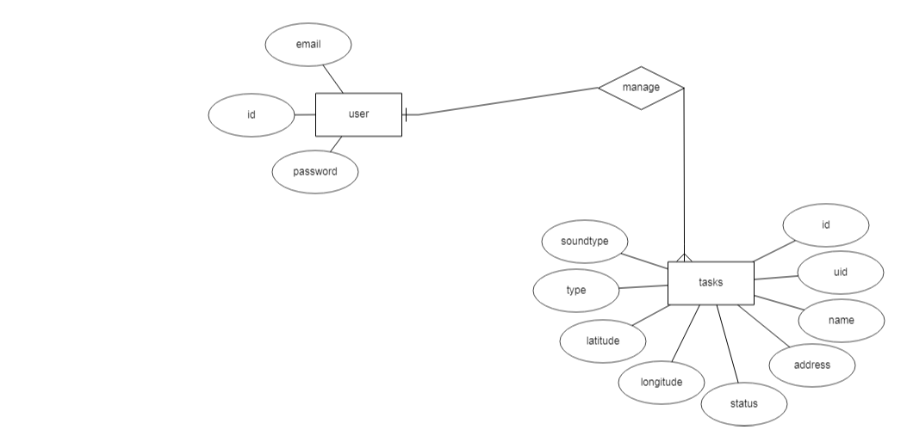
Entity-Relationship Diagram

Slide 17
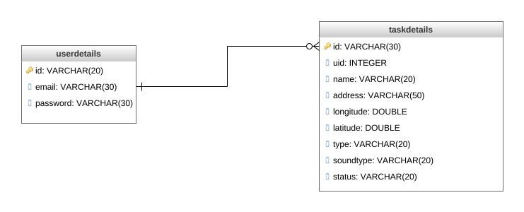
Database Diagram

Slide 18
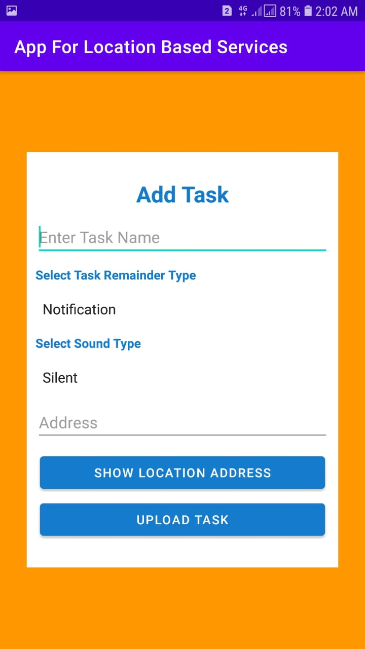
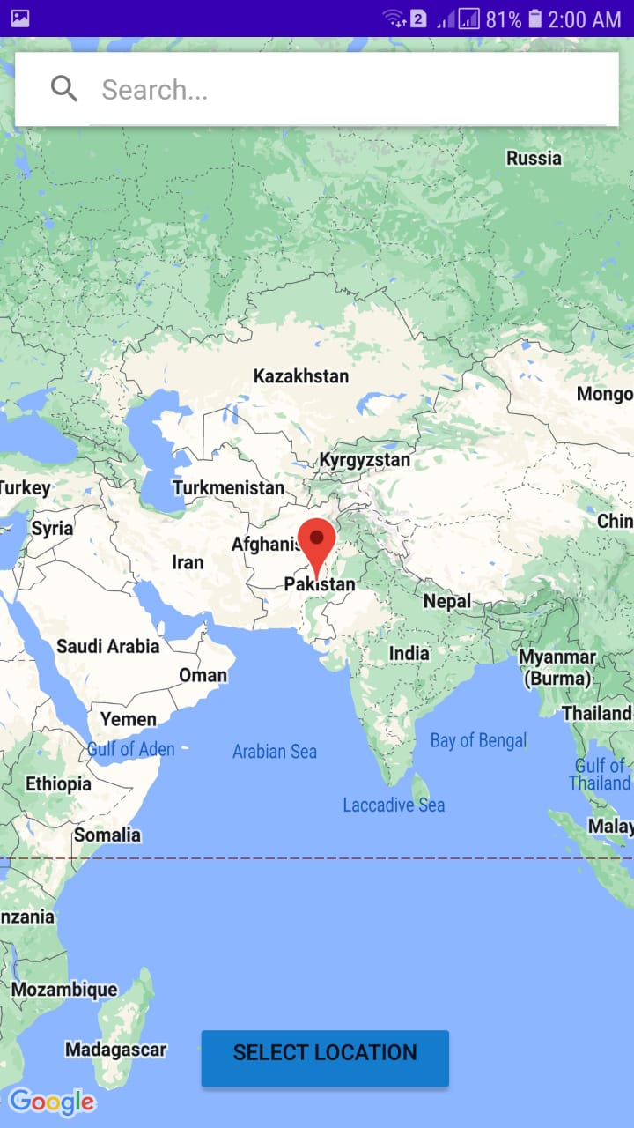
User Interfaces

Slide 19
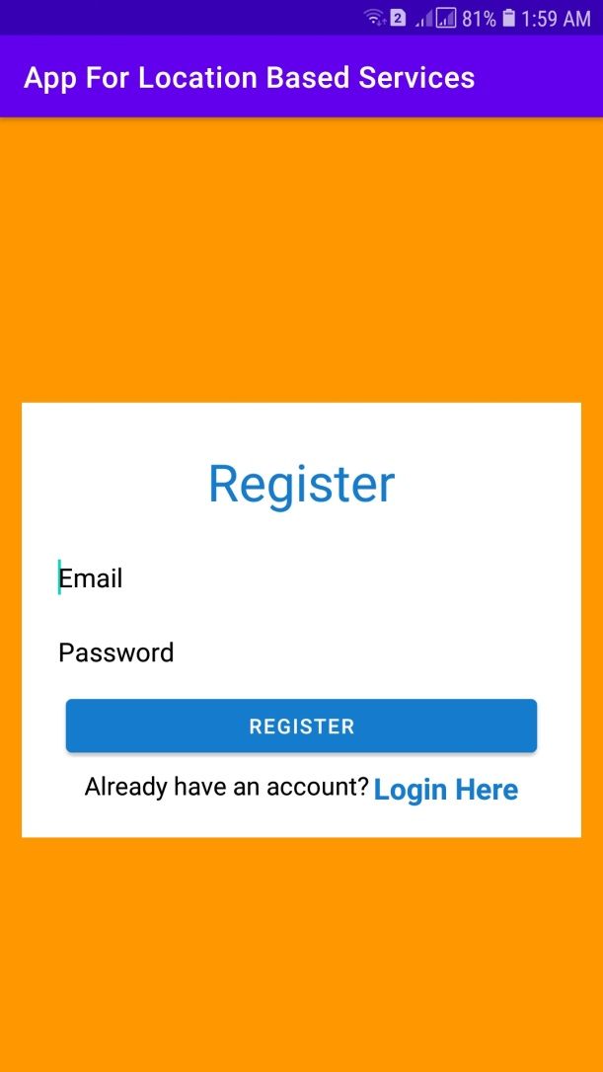
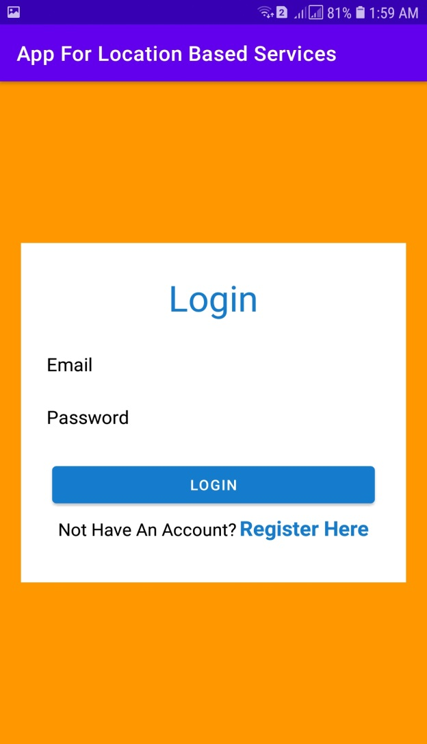
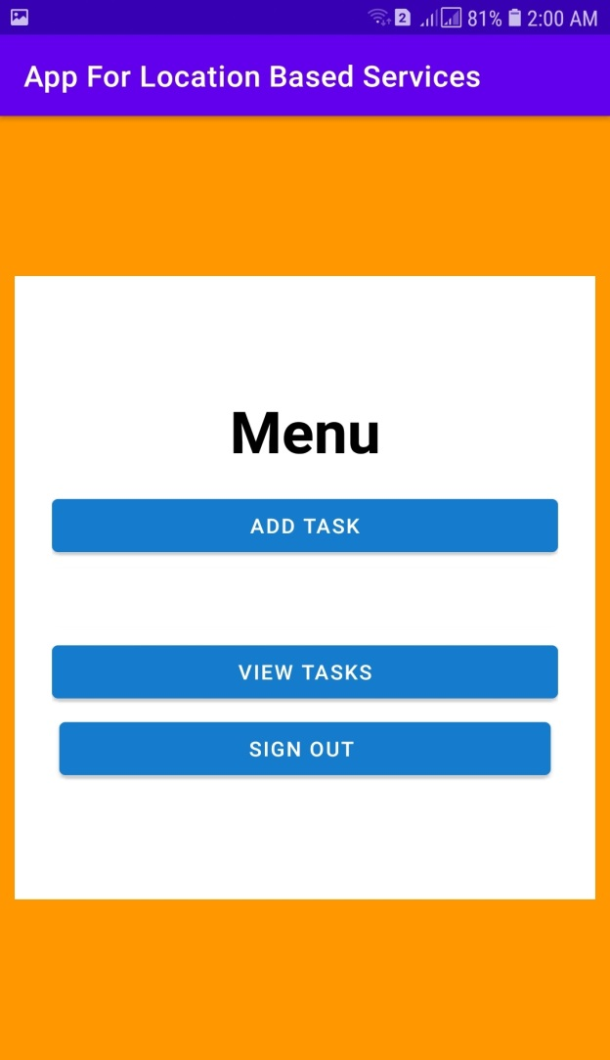

Slide 20
Tools
Android Studio.
AVD Manager.
Android SDK.
IDE

